Slide 1
Advanced & Graduate Education Class of 2020
Anthony Licari

Slide 2
The dean’s letter
Dean’s Letter aka Institutional Evaluation
The Dean’s Letter is needed for all programs
PASS
Match
Even programs that don’t participate in PASS or Match

Slide 3
What is the dean’s letter?
A letter from Dr. Probert that includes:
Your class rank & GPA (D1-D3 years)
Office of Education should have this information ready by the end of May
Might be later if there are a high number of “I” grades
National Boards Part 1
Date you took it and whether or not you passed
Highlights of your accomplishments during dental school

Slide 4
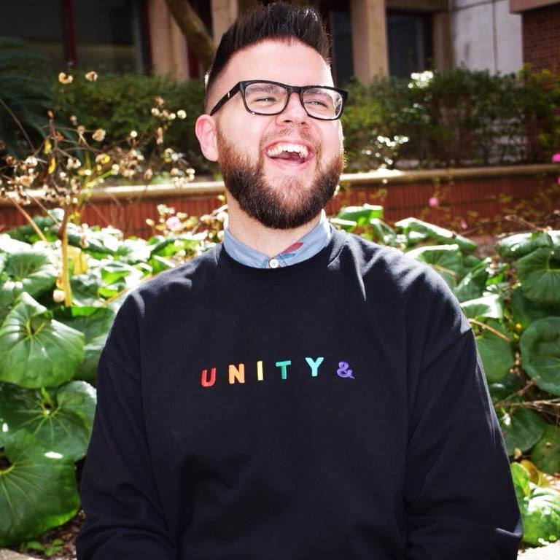
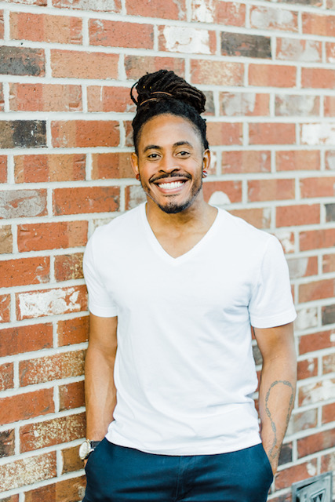
What do we need from you?
A well-written Dean’s Letter is a win/win for everyone!
Here’s what you’ll need to submit* for a Dean’s Letter
An updated CV
A signed Release for Letter of Recommendation
A list of programs you are applying to
* Submit these materials ELECTRONICALLY to:
Anthony Licari (ALicari@dental.ufl.edu)
Jerell Blackburn (Jerellblackburn@dental.ufl.edu)

Slide 5
Your Curriculum Vitae (CV)
Major Accomplishments
Awards, honors, and distinctions
Community service and volunteerism
Research and publications
Professional memberships, activities and experiences (include leadership positions)
Make sure it is easy to read and understand
Check your spelling, grammar, and format – it counts!
Keep it concise (around 2-3 pages)

Slide 6
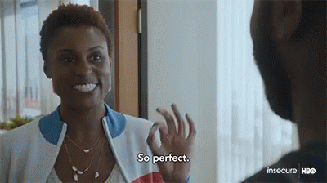
CV Example

Slide 7
Release for letter of recommendation
In order to write your letter, we need your permission to include FERPA-protected information (grades, class rank, etc.)
*You will need to complete a Release form for each faculty member you’ve requested a recommendation letter from
The Release for Letter of Recommendation is posted on the UFCD website
Home Page > Education > DMD Student > Residency Application Information
https://dental.ufl.edu/education/dmd-program/forms-publications/#advanced-graduate

Slide 8
Release Form Example
I give my permission to…
Dr. Patty Probert (or appropriate faculty)
All persons or entities listed here…
All programs I am applying to
I give my permission for…
Dr. Patty Probert (or appropriate faculty)
Check the boxes!
I hereby…
Waive
Do not waive

Slide 9
Don’t forget to sign the form

Slide 10
List of programs
The list should include
Specialty
Name of each school
Application deadline for each
Whether or not the program participates in PASS/Match
If a program does not participate in PASS/Match, tell us how to submit the letter
Email, online portal, USPS?
If USPS, provide Anthony or Jerell with a stamped envelope and the typed recipient address

Slide 11
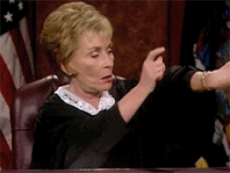
Timing is everything
Submit your materials as soon as they are ready!
Our goal this year is to complete your letters within 30 days of receiving your materials.
Your CV, signed release form, and program list should be submitted to us no later than 30 days before your earliest deadline
Please keep in mind that we are writing letters for alumni as well!

Slide 12
Questions?
Email or stop by our offices!
Anthony Licari – Room D4-33
ALicari@dental.ufl.edu
Jerell Blackburn – Room D4-32
Jerellblackburn@dental.ufl.edu
Dr. Patty Probert – Room D3-12
PProbert@dental.ufl.edu

