Slide 1
Advanced & Graduate Education Class of 2019
Dr. Patty Probert

Slide 2
The dean’s letter
Dean’s Letter aka Institutional Evaluation
The Dean’s Letter is needed for all programs
PASS
Match
Even programs that don’t participate in PASS or Match

Slide 3
What is the dean’s letter?
A letter from me that includes:
Your class rank (D1-D3 years)
Your GPA (D1-D3 years)
National Boards Part 1
Date you took it
Whether or not you passed
Highlights of your accomplishments during dental school

Slide 4
What do we need from you?
A well-written Dean’s Letter is a win/win for everyone!
Here’s what you’ll need to submit* for a Dean’s Letter
An updated CV
A signed Release for Letter of Recommendation
A list of programs you are applying to
* Submit these materials ELECTRONICALLY to Anthony Licari (ALicari@dental.ufl.edu)

Slide 5
Your Curriculum Vitae (CV)
Major Accomplishments
Awards, honors, and distinctions
Community service and volunteerism
Research and publications
Professional memberships
Professional activities and experiences (include leadership positions)
Professional references
Make sure it is easy to read and understand
Check your spelling, grammar, and format – it counts!

Slide 6
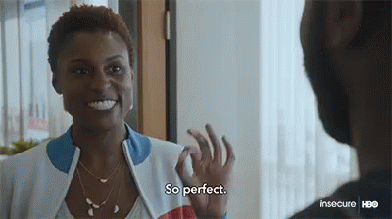
CV Example

Slide 7
Release for letter of recommendation
In order to write your letter, I need your permission to include FERPA-protected information (grades, class rank, etc.)
*You will need to complete a Release form for each faculty member
The Release for Letter of Recommendation is posted on the UFCD website
Home Page > Education > DMD Student > Residency Application Information

Slide 8
Release Form Example
I give my permission to…
Dr. Patty Probert (or appropriate faculty)
All persons or entities listed here…
All programs I am applying to
I give my permission for…
Dr. Patty Probert (or appropriate faculty)
I hereby…
Waive

Slide 9
Don’t forget to sign the form

Slide 10
List of programs
The list should include
Name of each school
You may include the address, but it isn’t required
Specialty (Endo, Oral Surgery, AEGD, etc.)
Application deadline for each program
Whether or not the program participates in PASS/Match
If a program does not participate in PASS/Match
Provide Anthony with a stamped envelope and the typed recipient address
Leave the return address area blank

Slide 11
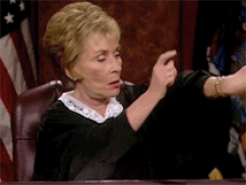
Timing is everything
Your CV, signed release form, and program list should be submitted to us no later than 30 days before your earliest deadline
If your earliest deadline is October 3, 2018 then your materials should be submitted no later than September 3, 2018.
30!

Slide 12
Questions?

